Slide 1
Decision Tree Algorithm

Slide 2
Outline
Introduction
Example
Principles
  Entropy
  Information gain
Evaluations
Demo

Slide 3
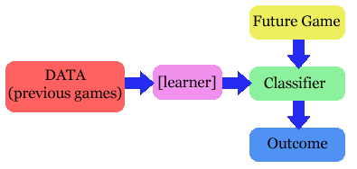
The problem
Given a set of training cases/objects and their attribute values, try to determine the target attribute value of new examples.
  Classification
  Prediction

Slide 4
Why decision tree?
Decision trees are powerful and popular tools for classification and prediction.
Decision trees represent rules, which can be understood by humans and used in knowledge system such as database.

Slide 5
key requirements
Attribute-value description: object or case must be expressible in terms of a fixed collection of properties or attributes (e.g., hot, mild, cold).
Predefined classes (target values): the target function has discrete output values (bollean or multiclass)
Sufficient data: enough training cases should be provided to learn the model.

Slide 6
A simple example
You want to guess the outcome of next week's game between the MallRats and the Chinooks.
Available knowledge / Attribute
  was the game at Home or Away
  was the starting time 5pm, 7pm or 9pm.
  Did Joe play center, or forward.
  whether that opponent's center was tall or not.
  …..

Slide 7
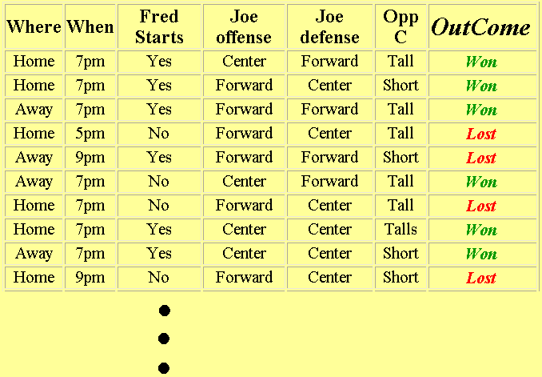
Basket ball data

Slide 8
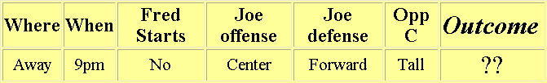
What we know
The game will be away, at 9pm, and that Joe will play center on offense…
A classification problem
Generalizing the learned rule to new examples

Slide 9
Definition
Decision tree is a classifier in the form of a tree structure
  Decision node: specifies a test on a single attribute
  Leaf node: indicates the value of the target attribute
  Arc/edge: split of one attribute
  Path: a disjunction of test to make the final decision
Decision trees classify instances or examples by starting at the root of the tree and moving through it until a leaf node.

Slide 10
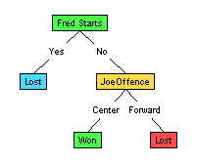
Illustration
(1) Which to start? (root)
(2) Which node to proceed?
(3) When to stop/ come to conclusion?

Slide 11
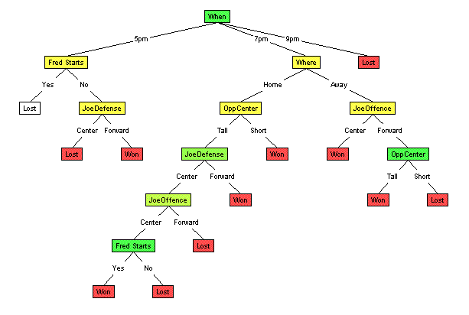
Random split
The tree can grow huge
These trees are hard to understand.
Larger trees are typically less accurate than smaller trees.

Slide 12
Principled Criterion
Selection of an attribute to test at each node - choosing the most useful attribute for classifying examples.
information gain
  measures how well a given attribute separates the training examples according to their target classification
  This measure is used to select among the candidate attributes at each step while growing the tree

Slide 13
Entropy
A measure of homogeneity of the set of examples.
Given a set S of positive and negative examples of some target concept (a 2-class problem), the entropy of set S relative to this binary classification is
E(S) = - p(P)log2 p(P) – p(N)log2 p(N)

Slide 14
Suppose S has 25 examples, 15 positive and 10 negatives [15+, 10-]. Then the entropy of S relative to this classification is
E(S)=-(15/25) log2(15/25) - (10/25) log2 (10/25)

Slide 15
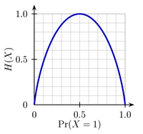
Some Intuitions
The entropy is 0 if the outcome is ``certain’’.
The entropy is maximum if we have no knowledge of the system (or any outcome is equally possible).
Entropy of a 2-class problem with regard to the portion of one of the two groups

Slide 16
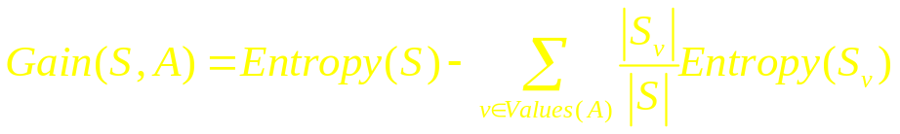
Information Gain
Information gain measures the expected reduction in entropy, or uncertainty.
  Values(A) is the set of all possible values for attribute A, and Sv the subset of S for which attribute A has value v Sv = {s in S | A(s) = v}.
  the first term in the equation for Gain is just the entropy of the original collection S
  the second term is the expected value of the entropy after S is partitioned using attribute A

Slide 17
It is simply the expected reduction in entropy caused by partitioning the examples according to this attribute.
It is the number of bits saved when encoding the target value of an arbitrary member of S, by knowing the value of attribute A.

Slide 18
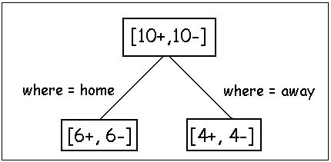
Examples
Before partitioning, the entropy is
  H(10/20, 10/20) = - 10/20 log(10/20) - 10/20 log(10/20) = 1
Using the ``where’’ attribute, divide into 2 subsets
  Entropy of the first set H(home) = - 6/12 log(6/12) - 6/12 log(6/12) = 1
  Entropy of the second set H(away) = - 4/8 log(6/8) - 4/8 log(4/8) = 1
Expected entropy after partitioning
  12/20 * H(home) + 8/20 * H(away) = 1

Slide 19
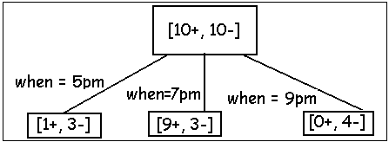
Using the ``when’’ attribute, divide into 3 subsets
  Entropy of the first set H(5pm) = - 1/4 log(1/4) - 3/4 log(3/4);
  Entropy of the second set H(7pm) = - 9/12 log(9/12) - 3/12 log(3/12);
  Entropy of the second set H(9pm) = - 0/4 log(0/4) - 4/4 log(4/4) = 0
Expected entropy after partitioning
  4/20 * H(1/4, 3/4) + 12/20 * H(9/12, 3/12) + 4/20 * H(0/4, 4/4) = 0.65
Information gain 1-0.65 = 0.35

Slide 20
Decision
Knowing the ``when’’ attribute values provides larger information gain than ``where’’.
Therefore the ``when’’ attribute should be chosen for testing prior to the ``where’’ attribute.
Similarly, we can compute the information gain for other attributes.
At each node, choose the attribute with the largest information gain.

Slide 21
Stopping rule
  Every attribute has already been included along this path through the tree, or
  The training examples associated with this leaf node all have the same target attribute value (i.e., their entropy is zero).
  Demo

Slide 22
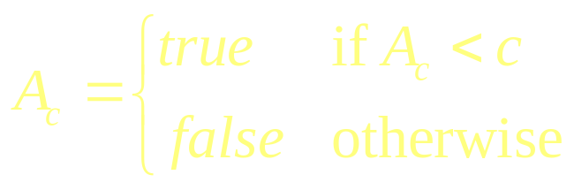
Continuous Attribute?
Each non-leaf node is a test, its edge partitioning the attribute into subsets (easy for discrete attribute).
For continuous attribute
  Partition the continuous value of attribute A into a discrete set of intervals
  Create a new boolean attribute A_{c} , looking for a threshold c,
How to choose c ?

Slide 23
Evaluation
Training accuracy
  How many training instances can be correctly classify based on the available data?
  Is high when the tree is deep/large, or when there is less confliction in the training instances.
  however, higher training accuracy does not mean good generalization
Testing accuracy
  Given a number of new instances, how many of them can we correctly classify?
  Cross validation

Slide 24
Strengths
can generate understandable rules
perform classification without much computation
can handle continuous and categorical variables
provide a clear indication of which fields are most important for prediction or classification

Slide 25
Weakness
Not suitable for prediction of continuous attribute.
Perform poorly with many class and small data.
Computationally expensive to train.
  At each node, each candidate splitting field must be sorted before its best split can be found.
  In some algorithms, combinations of fields are used and a search must be made for optimal combining weights.
  Pruning algorithms can also be expensive since many candidate sub-trees must be formed and compared.
Do not treat well non-rectangular regions.

